Slide 1
STA/BST 222 Survival Analysis Introduction
Lihong Qi
Division of Biostatistics
Department of Public Health Sciences
School of Medicine
Oct. 8, 2020

Slide 2
How to contact me
Email is best: lhqi@ucdavis.edu
Phone: 530-754-9234
Office hour: email for an appointment

Slide 3
How to contact TA
Xiner Zhou
Email: xezhou@ucdavis.edu
Office hours: 7:00pm – 8:00pm, Thursdays
Lab: 6:10-7:00 pm, Thursdays
For both Lab and OH, please use the zoom link with passcode: survival https://ucdstats.zoom.us/j/9681353237?pwd=ZzhLRHlhNG92bHFUaHkwM0Fib1pqQT09 Meeting ID: 968 135 3237

Slide 4
Outline
Introduction
Censoring and truncation
Methods for describing survival data
Summary
Homework

Slide 5
Survival Outcome Variables
What is the event?
Where is the time origin?
What is the time scale?
What is the censoring and truncation mechanism?

Slide 6
Right censoring: Type I
Censoring time is pre-specified.
Progressive Type I censoring
Individuals enter the study at the same time but can have different, pre-specified censoring times
Generalized Type I censoring
Individuals enter the study at different times and censoring times are predetermined.
Representation: can shift starting time to 0

Slide 7
Generalized Type I censoring

Slide 8
Truncation
Truncation: A truncated observation is one which is unobservable due to a selection process inherent in the study design.
individuals enter the study only if they survive a sufficient length of time or individuals are included in the study only if the event has occurred by a given date.
For truncated data, only subjects who satisfy the condition are observed by the investigator.
The condition is usually associated with a truncation time
Left and right truncation

Slide 9
Left Truncation
Arises when only individuals who have not experienced the event of interest before truncation time are included in the sample.

Slide 10
Example: Channing House KM 1.16
Channing House is a retirement center in Palo Alto, CA
All the residence were covered by a health care program provided by the center
Ages at death of 462 individuals who were in residence during Jan 1964 to July 1975 are recorded
Ages at which individuals entered the retirement center are also recorded
Left truncation
an individual must survive to a sufficient age to enter the retirement center.
Why left truncation matters?

Slide 11
Example: astronomical data
With a given telescope, we can only detect a very distant stellar object which is brighter than some limiting flux — the object is left-truncate if it lies beyond detection by our telescope – we cannot tell if the object is even there if we cannot see it.

Slide 12
Right Truncation
Arises when only individuals who have experienced the event of interest are included in the sample.

Slide 13
Example: AIDS
Only those who developed AIDS were asked for their infection dates
Data: infection and induction times for 258 adults who were infected with AIDS virus and developed AIDS by 6/30/1986
Time in years infected by AIDS virus (from 4/1/1978)
Waiting time to the development of AIDS (from the date of infection)
Ques: What is the time and condition of truncation?

Slide 14
Summary
Identify/Define time origin and time scale
Identify censoring mechanism: event time not observed
Right, left, interval
Type I, type II, random
Identify truncation: not in the data
Left, right

Slide 15
Censoring vs. Truncation
Censoring is about leaving the study: in the study without observing the exact event time
Truncation is about entering the study: not in the study if truncated
The main difference: censored subjects are included in the analysis but not truncated subjects.

Slide 16
Exercise: the WHI Diet and Breast Cancer study
Patients and Methods The trial randomly assigned 48,835 postmenopausal women with normal mammograms and without prior breast cancer from 1993 to 1998 at 40 US clinical centers to a dietary intervention with goals of a reduction of fat intake to 20% of energy and an increased intake of fruits, vegetables, and grains (40%; n = 19,541) or to a usual diet comparison (60%; n = 29,294).
Ques: What is the time and condition of truncation?
Chlebowski RT, Aragaki AK, Anderson GL, Thomson CA, Manson JE, Simon MS, Howard BV, Rohan TE, Snetselar L, Lane D, Barrington W, Vitolins MZ, Womack C, Qi L, Hou L, Thomas F, Prentice RL. Low-Fat Dietary Pattern and Breast Cancer Mortality in the Women's Health Initiative Randomized Controlled Trial. J Clin Oncol. 2017 Sep 1;35(25):2919-2926.

Slide 17
Exercise: the WHI DM study
The WHI is the largest US health study in a multiethnic group of postmenopausal women aged 50-79 years, and consists of four randomised controlled clinical trials and an observational study. This study involves 40 clinical centres and recruited over 160,000 women between 1993 and 1998.
We considered a time-to-event outcome which was time-to-diabetes for diabetic participants and censoring time for non-diabetic participants as of September 2005.
A woman had diabetes mellitus (DM) at baseline if she reported at study entry that she had received a physician diagnosis of sugar diabetes when not pregnant and received glucose-lowering medications. Age range when a participant was first told to have non-pregnancy-related diabetes was reported as <21, 21–29, 30– 39, 40–49, 50–59, 60–69 or 70 years or older.
Ques: What is the time and condition of censoring/truncation?

Slide 18
Exercise: the WHI DM study
A participant was diabetic if she had been treated for diabetes at baseline or during follow-up as of September 2005.
Participants had diabetes during follow-up if they reported a new physician diagnosis of diabetes treated with glucose-lowering agents. Assuming birth as time 0, time to diabetes was considered as the event time for participants with diabetes, and for participants who did not have diabetes as of September 2005, their last time of follow-up or death time was the censoring time.
Ques: What is the time and condition of censoring/truncation?

Slide 19
Why important
Observed time, failure times, censoring times
The design of survival experiments involving censoring and truncation needs to be carefully considered when constructing likelihood functions.
A critical assumption is that the lifetimes/failure times/event times and censoring times are independent.

Slide 20
Our focus
Right censoring

Slide 21
How to describe survival data?

Slide 22
Examples of the questions of interest in survival analysis:
What is the probability that a participant survives 5 years?
Are there differences in survival between groups (e.g., between those assigned to a new versus a standard drug in a clinical trial)?
How do certain personal, behavioral or clinical characteristics affect participants' chances of survival?

Slide 23
How to describe survival data?
Time T (t): nonnegative random variable from a homogeneous population
Event indicator: I(d=1)
Survival function: chance of surviving longer than t
Hazard function (rate): instant risk
Cumulative hazard function
Mean survival time
Median survival time

Slide 24
Survival function
Survival function: probability of surviving beyond time t (experiencing the event after time t)
Chance of surviving longer than some time t
Also known as survivor or survivorship function, or reliability function (in the context of equipment or manufactured item failures).
Denoted as S(t)=Pr(T>t).
S(0)=?
S(∞)=?

Slide 25
Survival Function
Non-increasing function of time.
S(t1) ≤ S(t2) if t1 ? t2
0≤ S(t) ≤ 1
An example

Slide 26
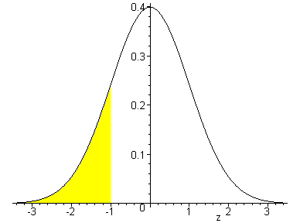
S(t)=1-F(t)
Probability density function (pdf)
Lognormal distribution, i.e. log(T)~normal distribution
F(t) = Pr(T <= t)
S(t)
F(t)
Log(T)

Slide 27
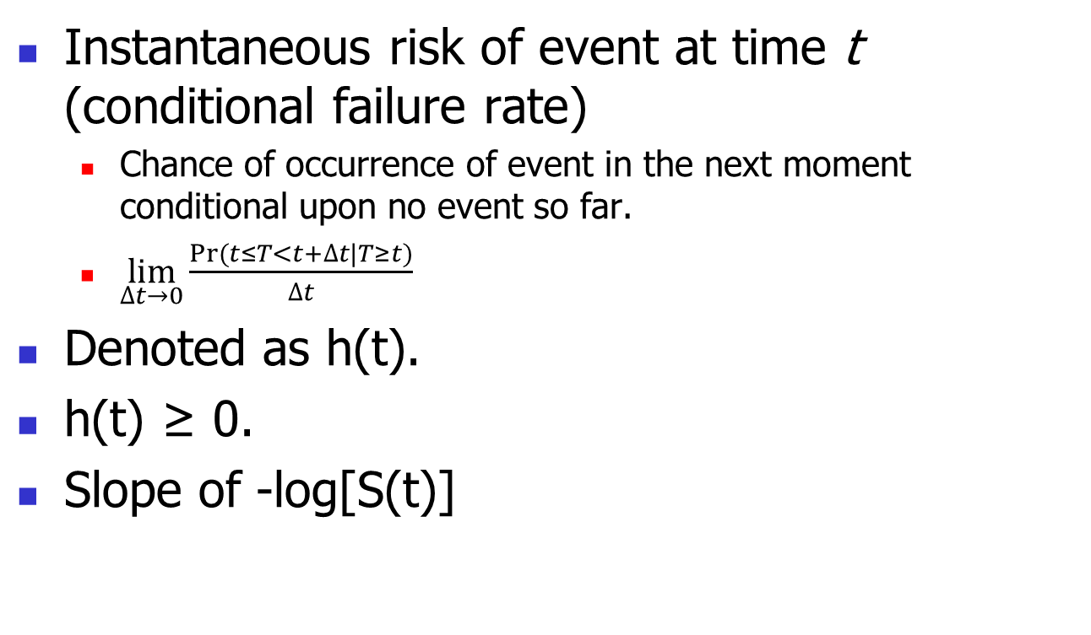
Hazard Function
Instantaneous risk of event at time t (conditional failure rate)
Chance of occurrence of event in the next moment conditional upon no event so far.
$\lim_{∆t→0}{\frac{Pr⁡(t≤T<t+∆t|T≥t)}{∆t}}$
Denoted as h(t).
h(t) ≥ 0.
Slope of -log[S(t)]

Slide 28
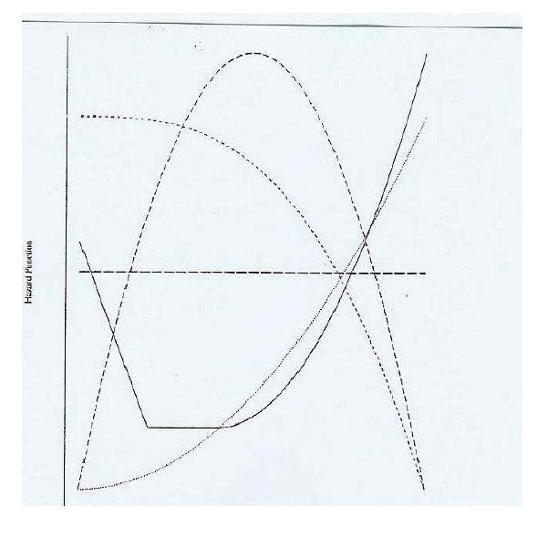
Shapes of generic hazard function
Constant
Decreasing: less common; in patients experiencing certain types of transplants
Increasing. Eg natural aging or wear
Bathtub. E.g. most population mortality data
Quadratic. Eg. recovery after surgery

Slide 29
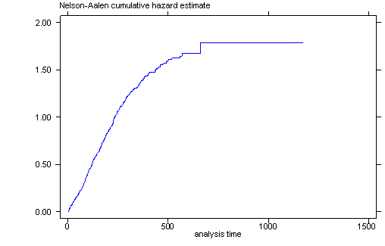

Cumulative Hazard Function
Cumulative risk up to time t.
Denoted H(t)=$\int_{0}^{t}{h\left(u\right)du}$.
H(t)≥0.
Non-decreasing function. Why?

Slide 30
Relationship between survivor and hazard functions
Hazard function is the derivative of the -log survivor function over time, i.e. h(t)=-d[ln(S(t))/dt].
Survivor and hazard functions can be converted into each other
h(t)=f(t)/S(t), where f(t) is the pdf of failure time.
H(t)=-ln[S(t)]
h(t)=dH(t)/dt

Slide 31
Summary
Truncation: A truncated observation is one which is unobservable due to a selection process inherent in the study design.
Left and right truncation
Methods for describing survival data:
Survival function: chance of surviving longer than t
Hazard function: instant risk
Cumulative hazard function
h(t)=f(t)/S(t)
H(t)=-ln[S(t)]
h(t)=dH(t)/dt

Slide 32
Homework 1
Reading the textbook KM, Chapter 2.1 – 2.3, 3.1-3.4
Answer the following questions:
What are the new things you’ve learned, or new understanding of something you knew before?
How would you apply them to your research/project?
Prepare for group discussions in next class.
Reading the textbook KM, Chapter 1, and identify examples for different censoring and truncation mechanisms. Answering the following:
What is the event? What is the time origin? What is the time scale? What is the censoring and/or truncation mechanism? Due by next Thursday.
Think about and write down your specific goals for this course, develop a specific and practical plan to achieve your goals. Be specific. Due by next Thursday.

